Slide 1
Speech Control Care Robot
CSIE5047 Robotics: Final Project Presentation
Group 9
宋體淮 R09921135 魏向泓 R10921080
張鑫揚 R10921013 林聖邦 R10921077

Slide 2
Outline
Introduction
System Overview
Methodology
Demonstration

Slide 3
Outline
Introduction
System Overview
Methodology
Demonstration

Slide 4
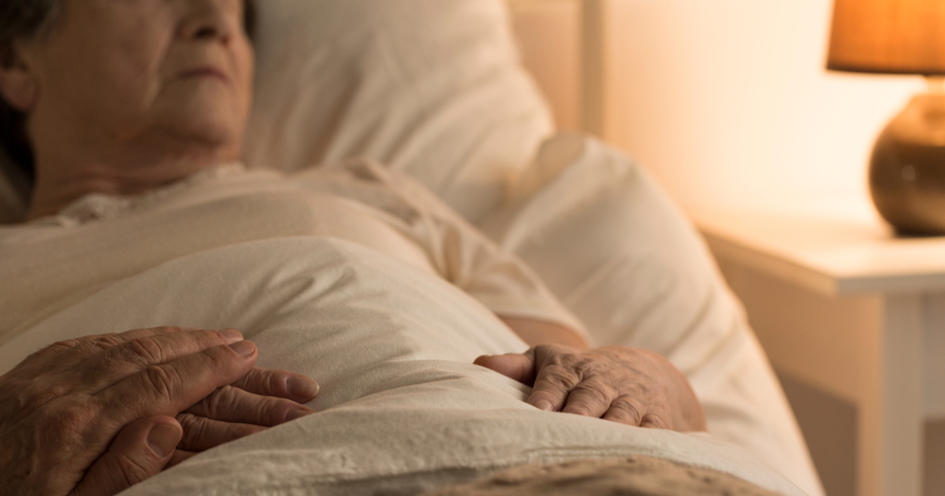
Introduction―Motivation
For those bedridden patients, it is difficult for them to walk around and grab something thay want easily.
Human-caring is exhausted and time-consuming.
Robot can be deployed all year round.

Slide 5
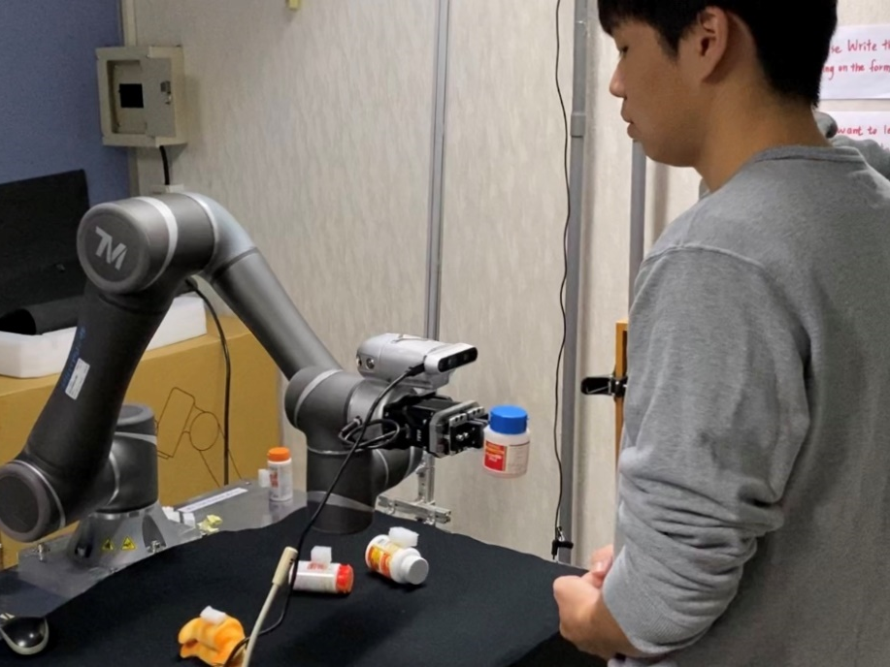
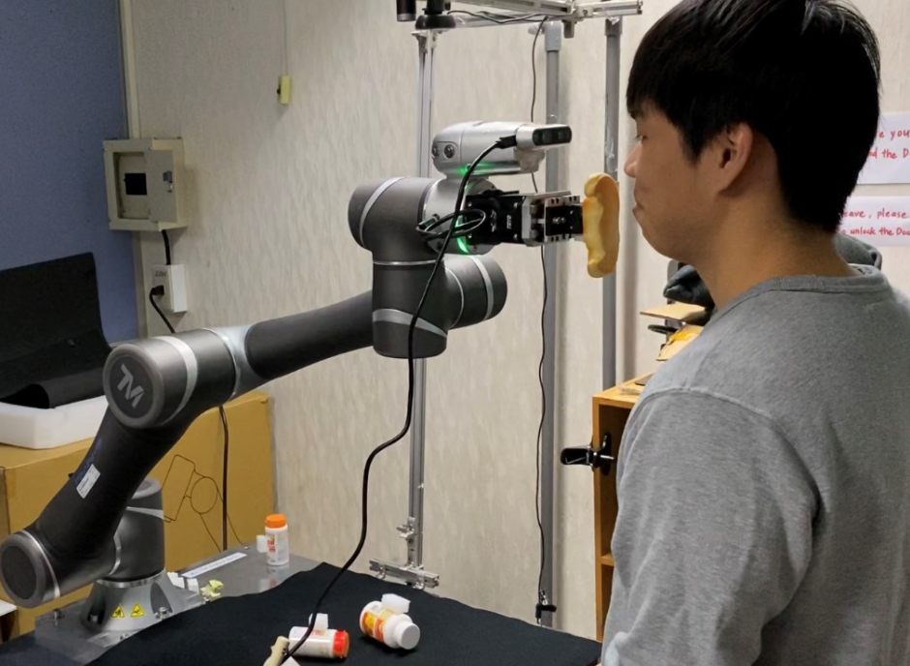
Introduction―Objective
Devise a robot system that can perform the following two functions via speech commands:
Give the object you
describe for you
Feed you the food
you describe

Slide 6
Outline
Introduction
System Overview
Methodology
Demonstration

Slide 7
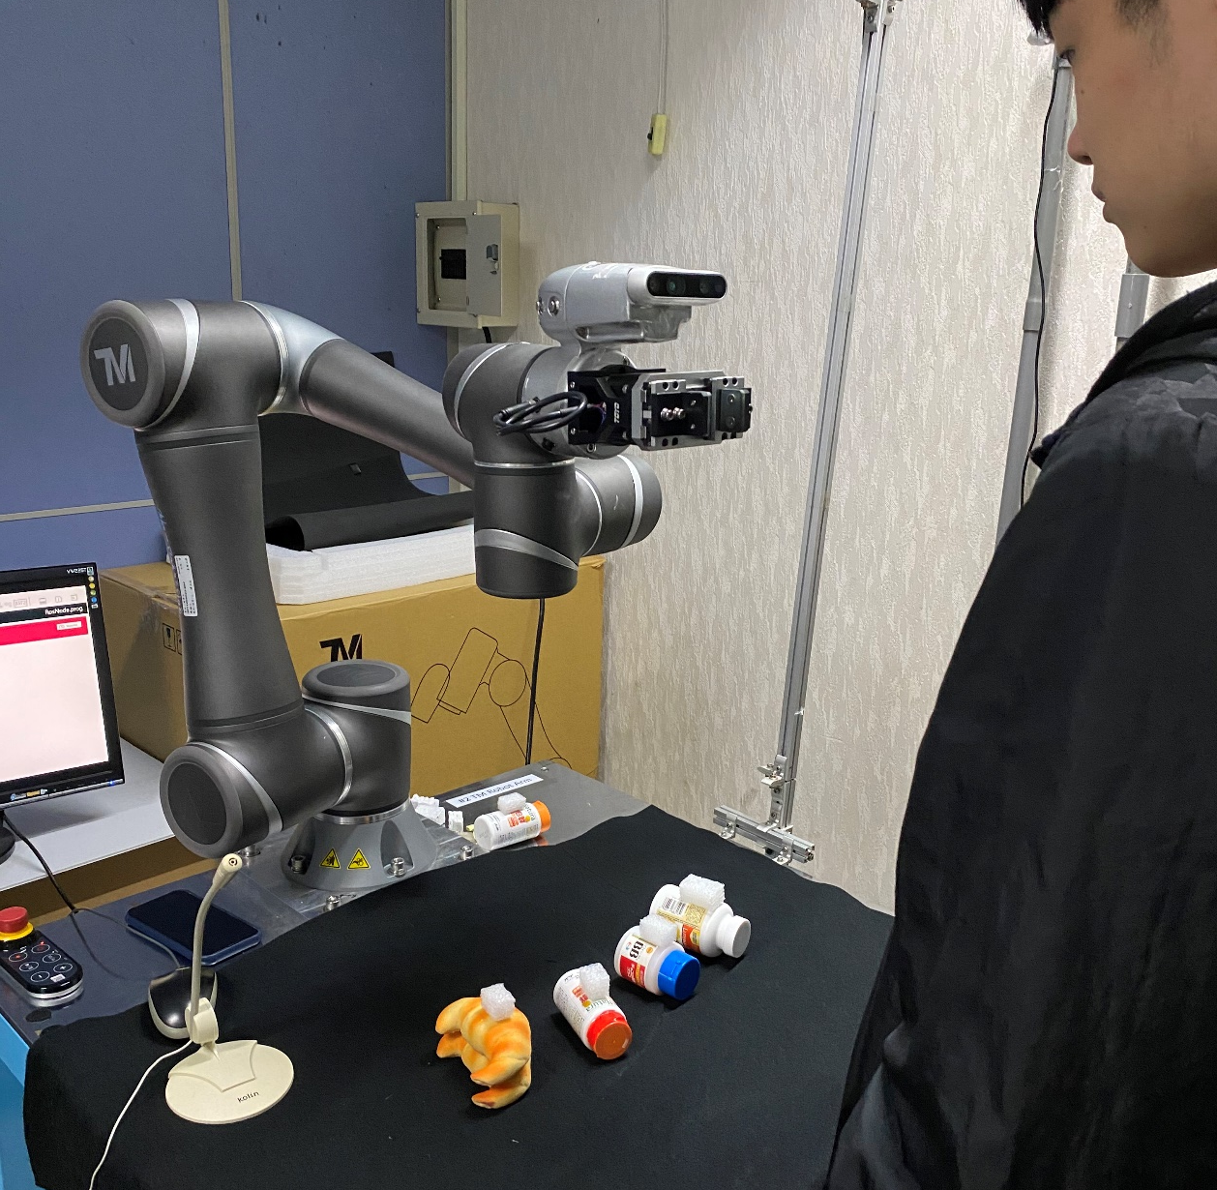
System Overview―Settings
• RealSence
• TM5-900
Robot Arm
• Workspace
• Microphone

Slide 8
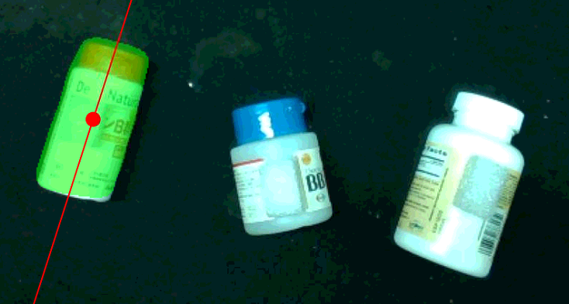

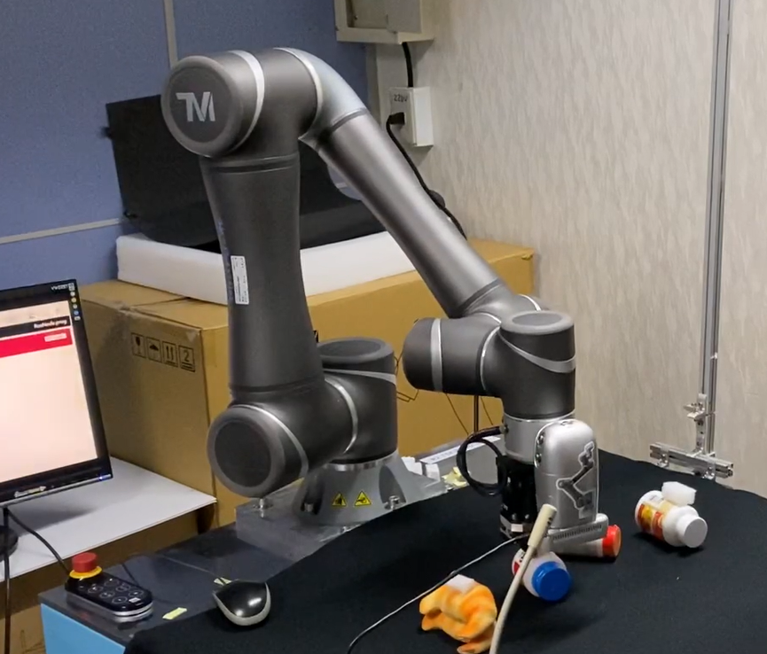

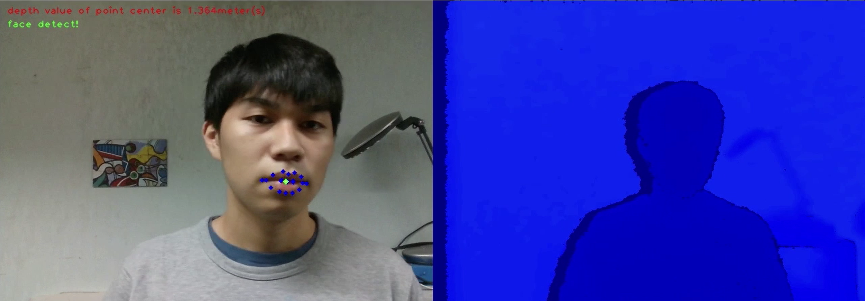
System Overview―Flowchart
Locate the
object
Object Grasping
Natural Language
Processing
Pick up the object
Speech
Command
Give/Feed?
Determine
the action
Action
Performing
Track
person
Visual Tracking

Slide 9
Outline
Introduction
System Overview
Methodology
Natural Language Processing
Visual Tracking
Demonstration

Slide 10
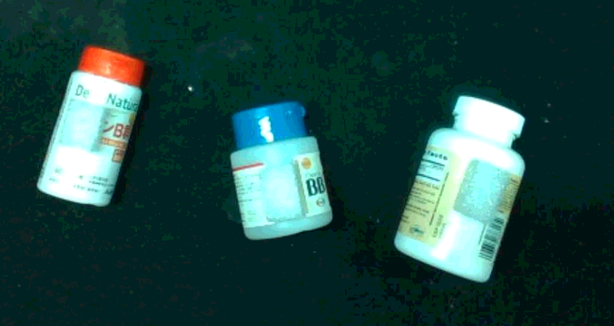
Natural Language Processing―Concept
“Please give me the medicine jar on the left”

Slide 11
Natural Language Processing―Concept
Action Subtext
(which action to perform)
“Please give me the medicine jar on the left”

Slide 12
Natural Language Processing―Concept
Action Subtext
(which action to perform)
Object Subtext
(what object to pick)
“Please give me the medicine jar on the left”

Slide 13

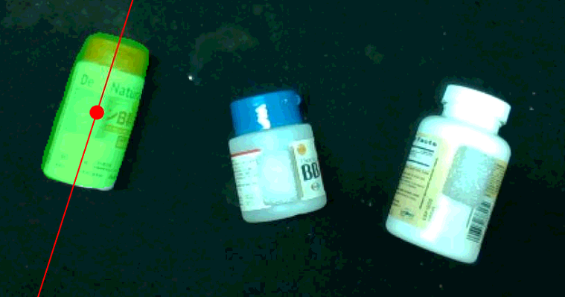
Natural Language Processing―Flowchart
RIS: Refering Image Segmentation
Speech-to-text
“please give me the medicine jar on the left”
BERT₁
Give
Feed
Classify
BERT₂
Split sentence
Action Subtext: please give me
Robot
Control
Object Subtext: the medicine jar
on the left
RIS

Slide 14
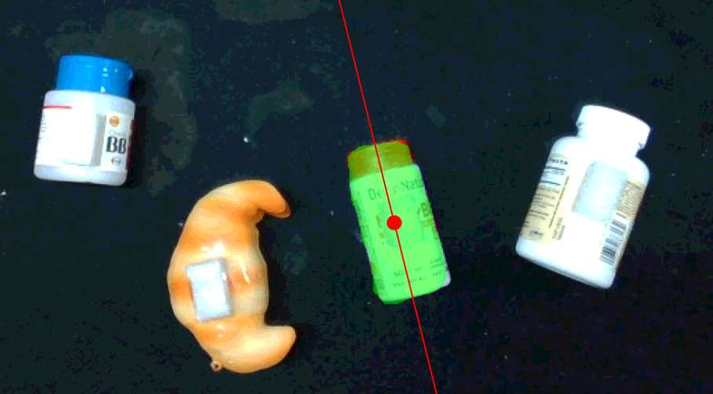
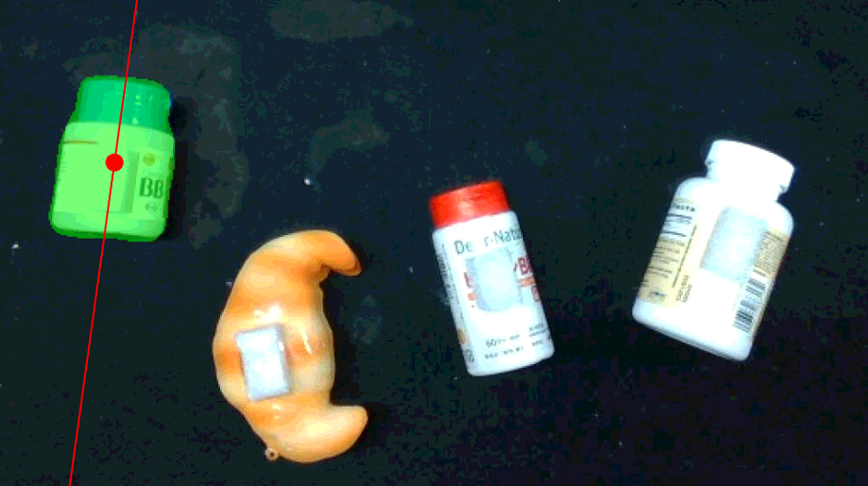
Natural Language Processing―Results
Describe by location:
Describe by apperance:
“the second medicine jar from the right”
“the medicine jar with blue cover”

Slide 15
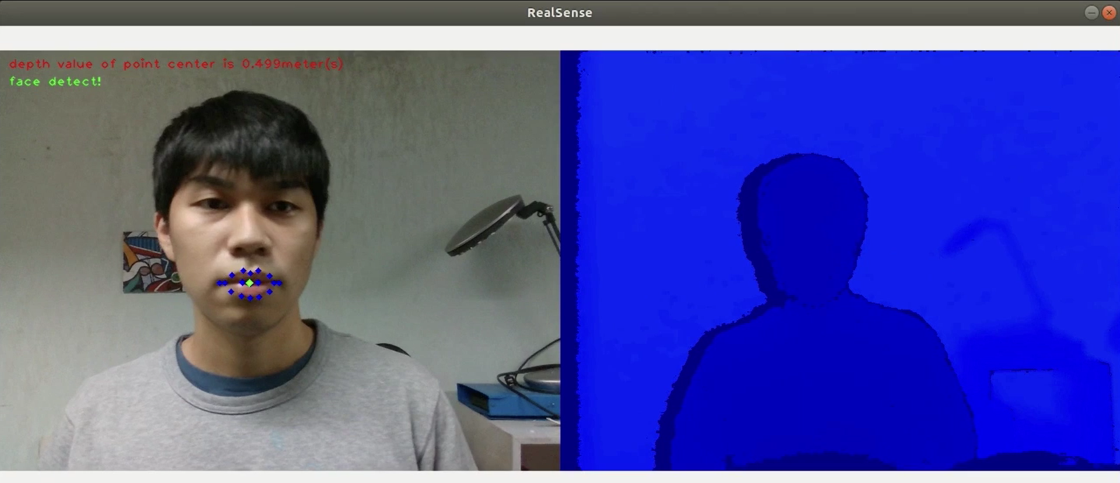
Visual Tracking
Use Face Recognition to detect mouth.
Use RealSence to detect distance.

Slide 16
Outline
Introduction
System Overview
Methodology
Demonstration

Slide 17
Demonstration
Demo video

Slide 18
Thanks for your attention! Any Question?

